Slide 1
Global environmental situation
We can solve everything in a year?

Slide 2
Current situation
Global overview of the health of the planet
Water
Earth
Air
Impact on the environment

Slide 3
Can we solve the problem in 1 year?
Assumptions
Practical Actions
Financial impact
Conclusions

Slide 4
Air
Pollution factors:
Vehicle emissions
Industry
Energy production
Agriculture
Construction

Slide 5
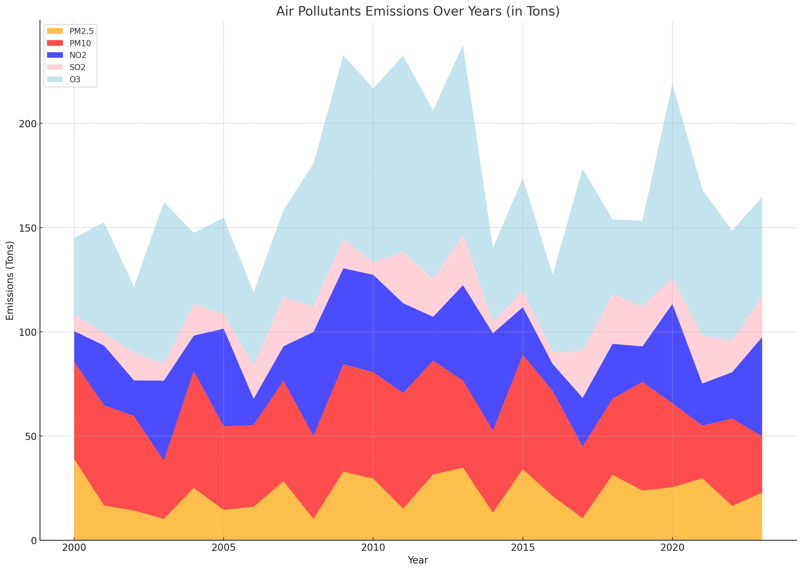
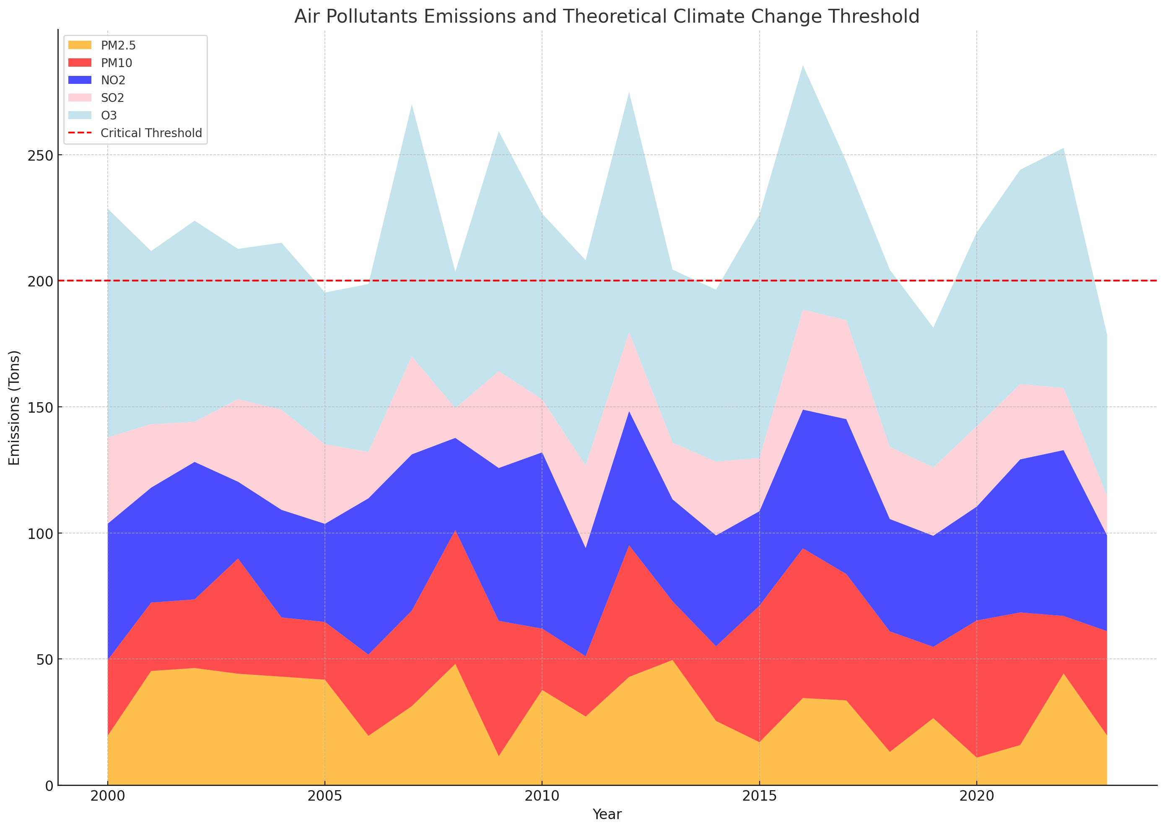
Air Pollution

Slide 6
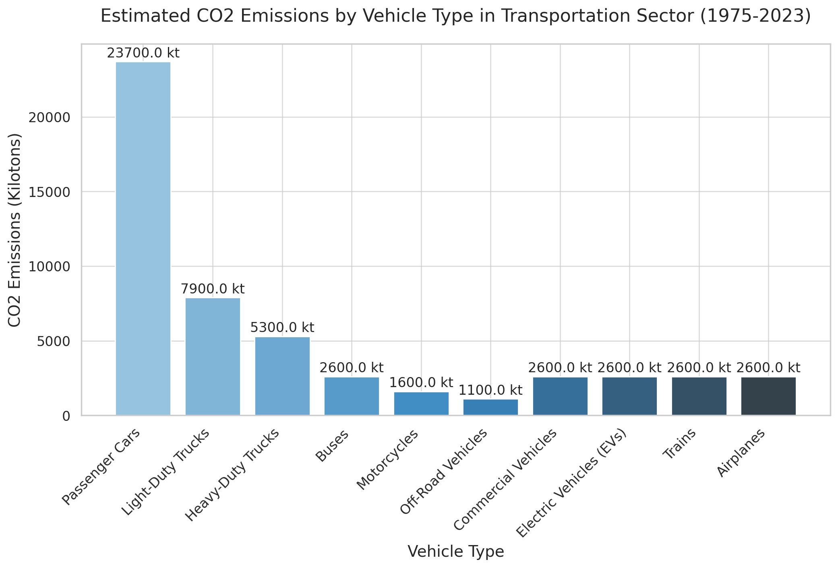
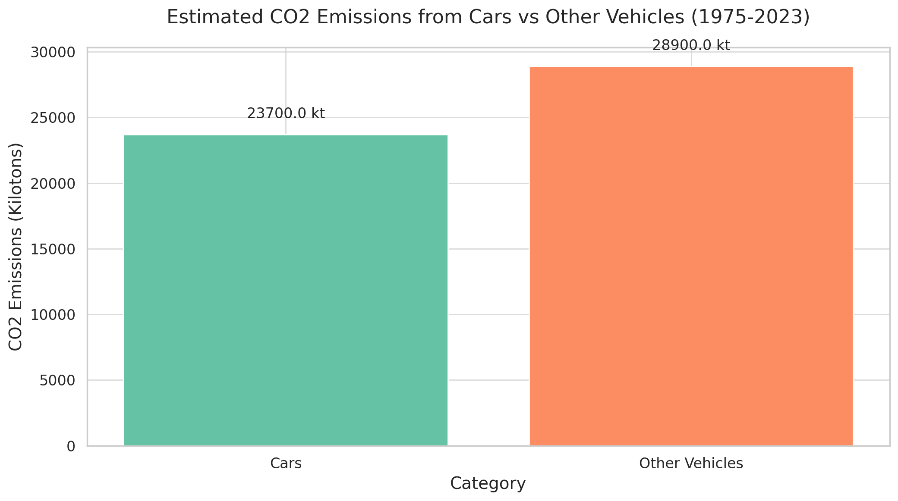
Vehicle emissions

Slide 7
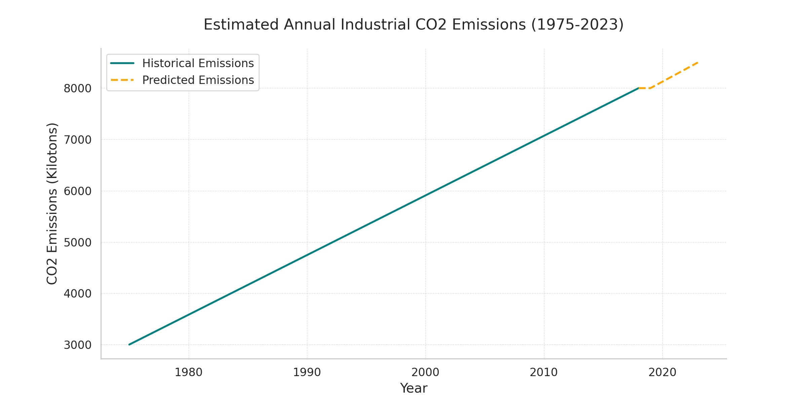
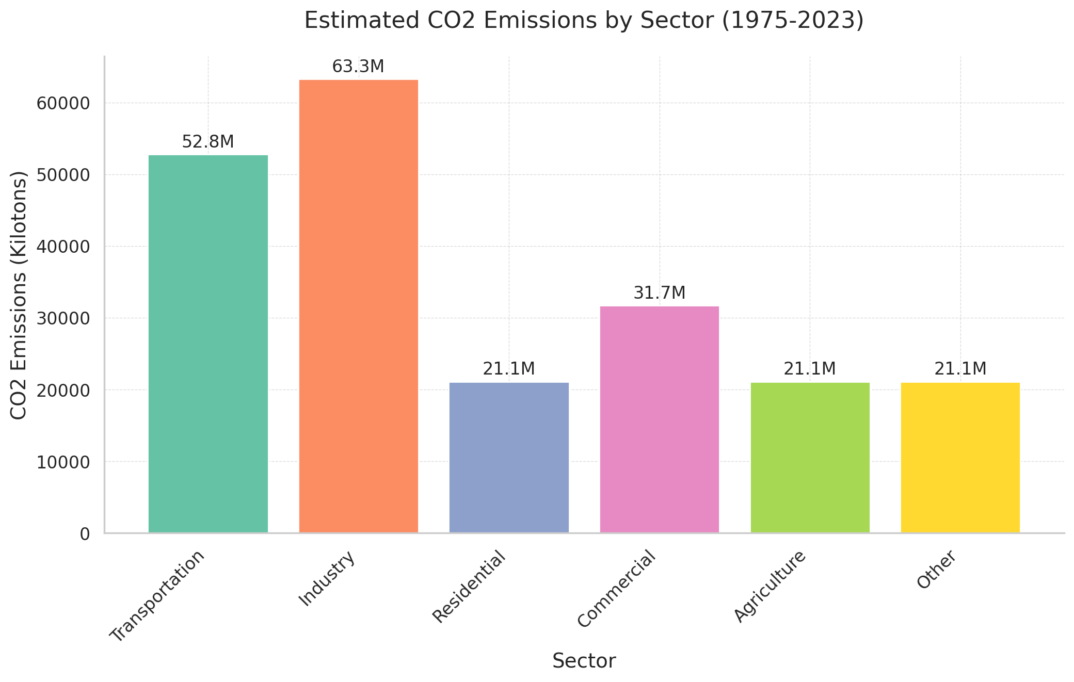
Industrial Pollution

Slide 8
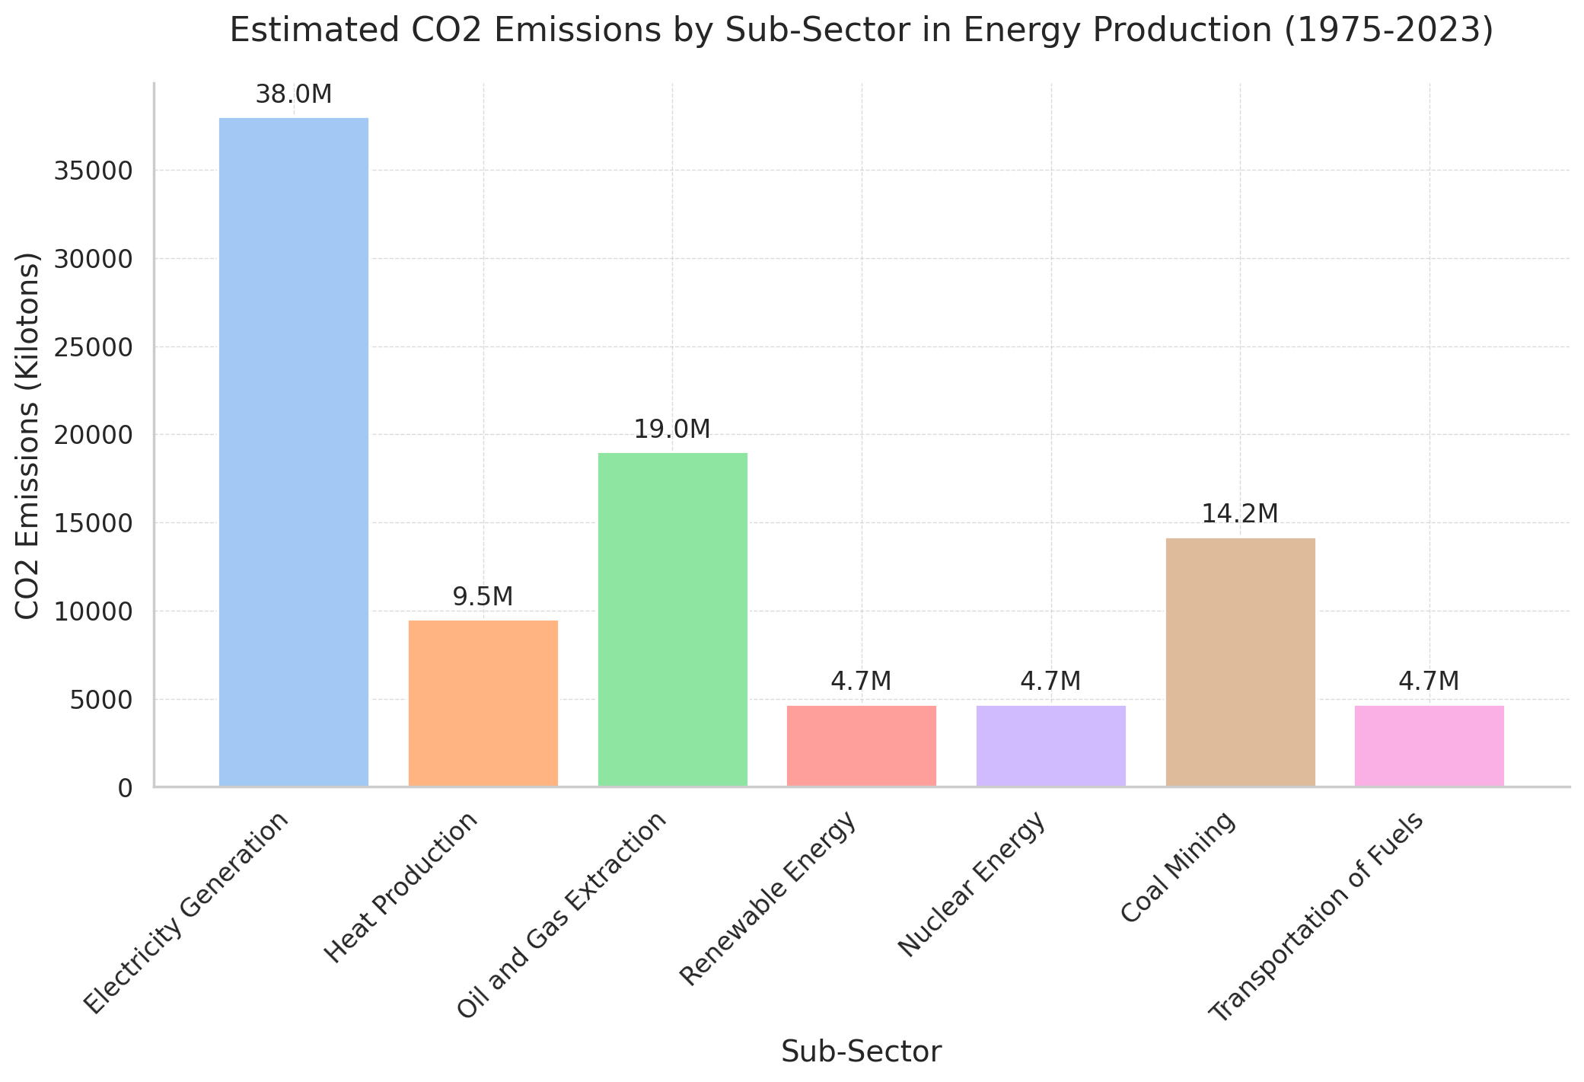
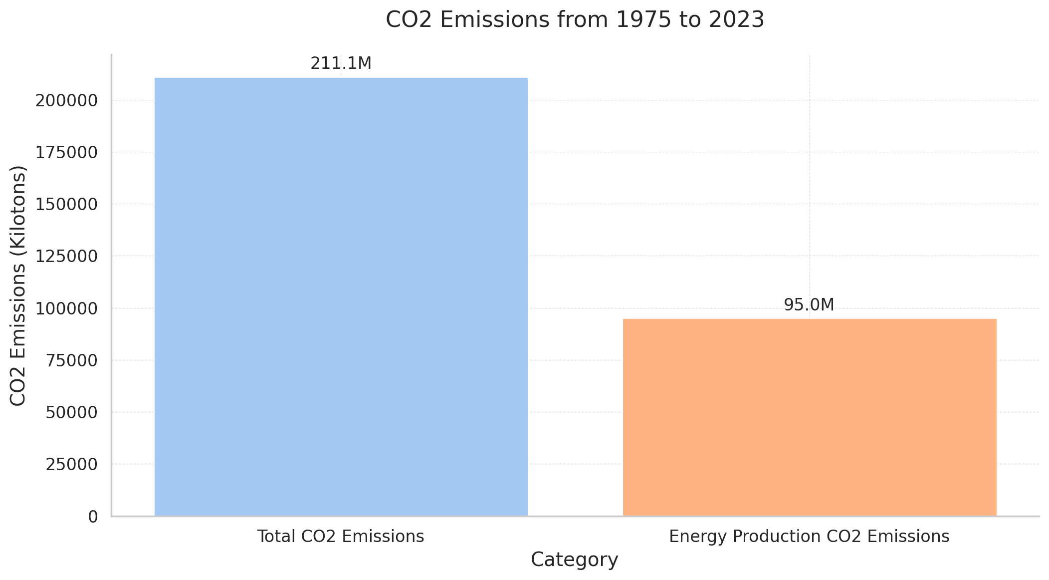
Energy production

Slide 9
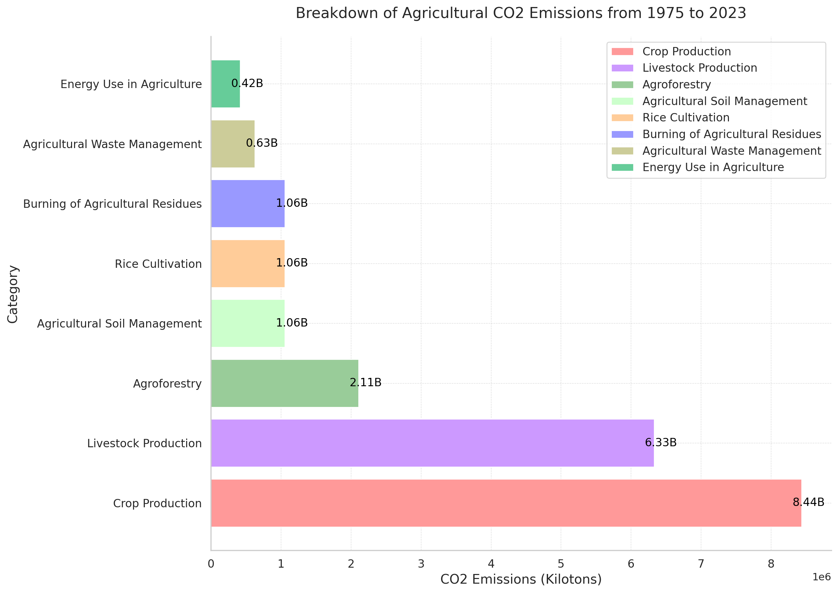
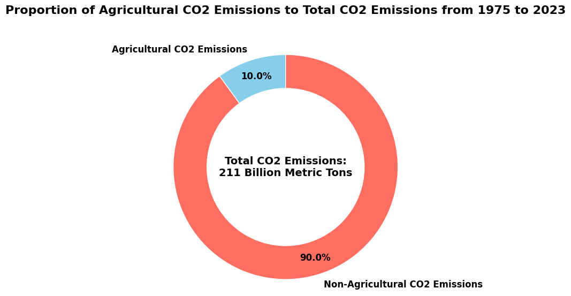
Agriculture

Slide 10
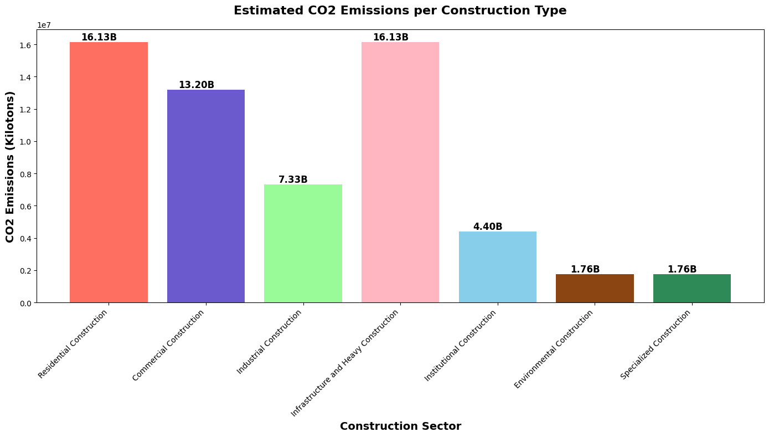
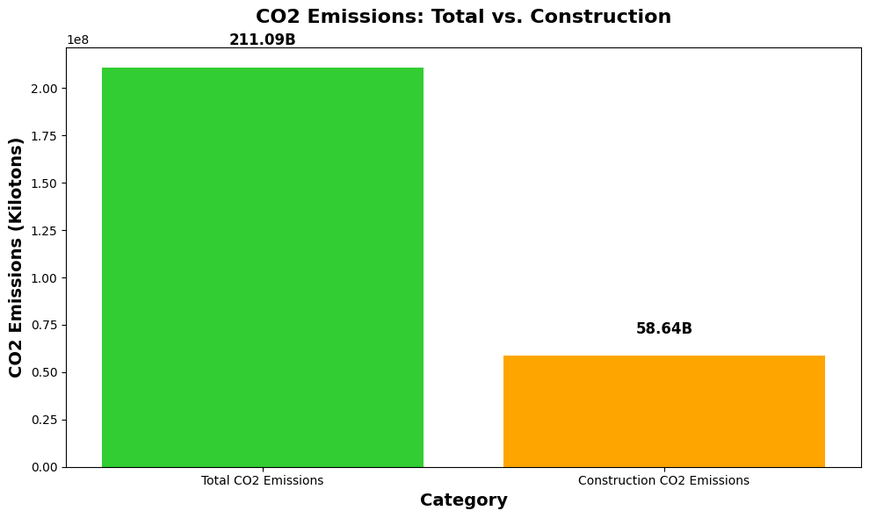
Construction

Slide 11
Water
Industry
Agriculture
Waste

Slide 12
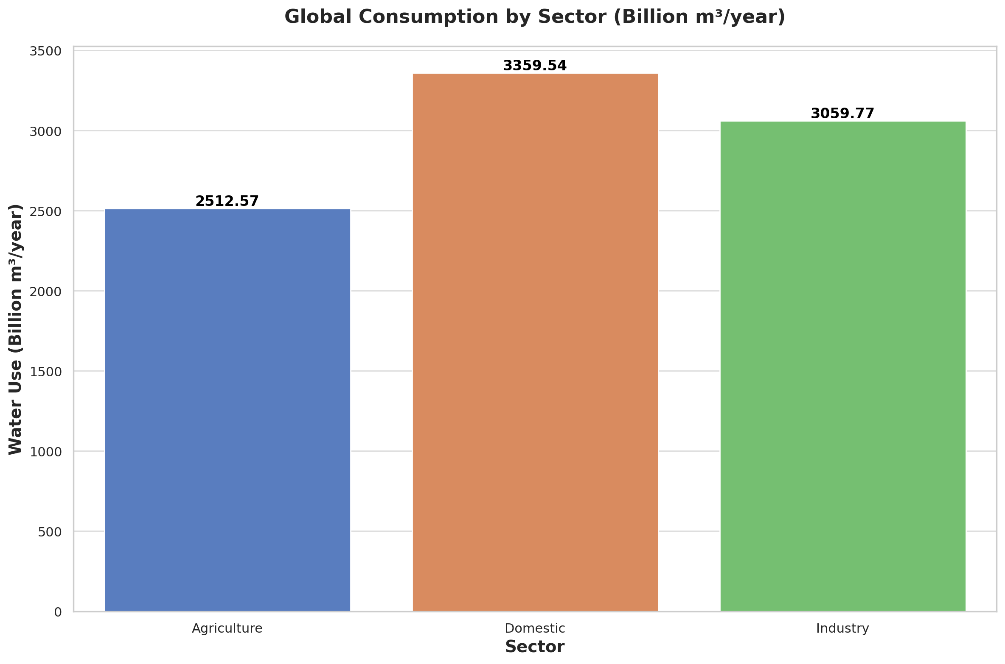
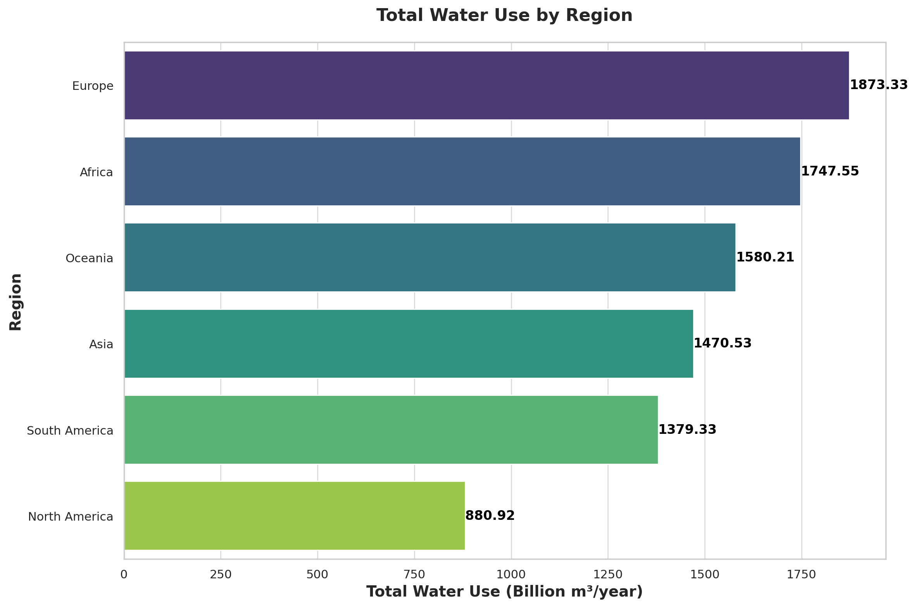
Water Global Consumption

Slide 13
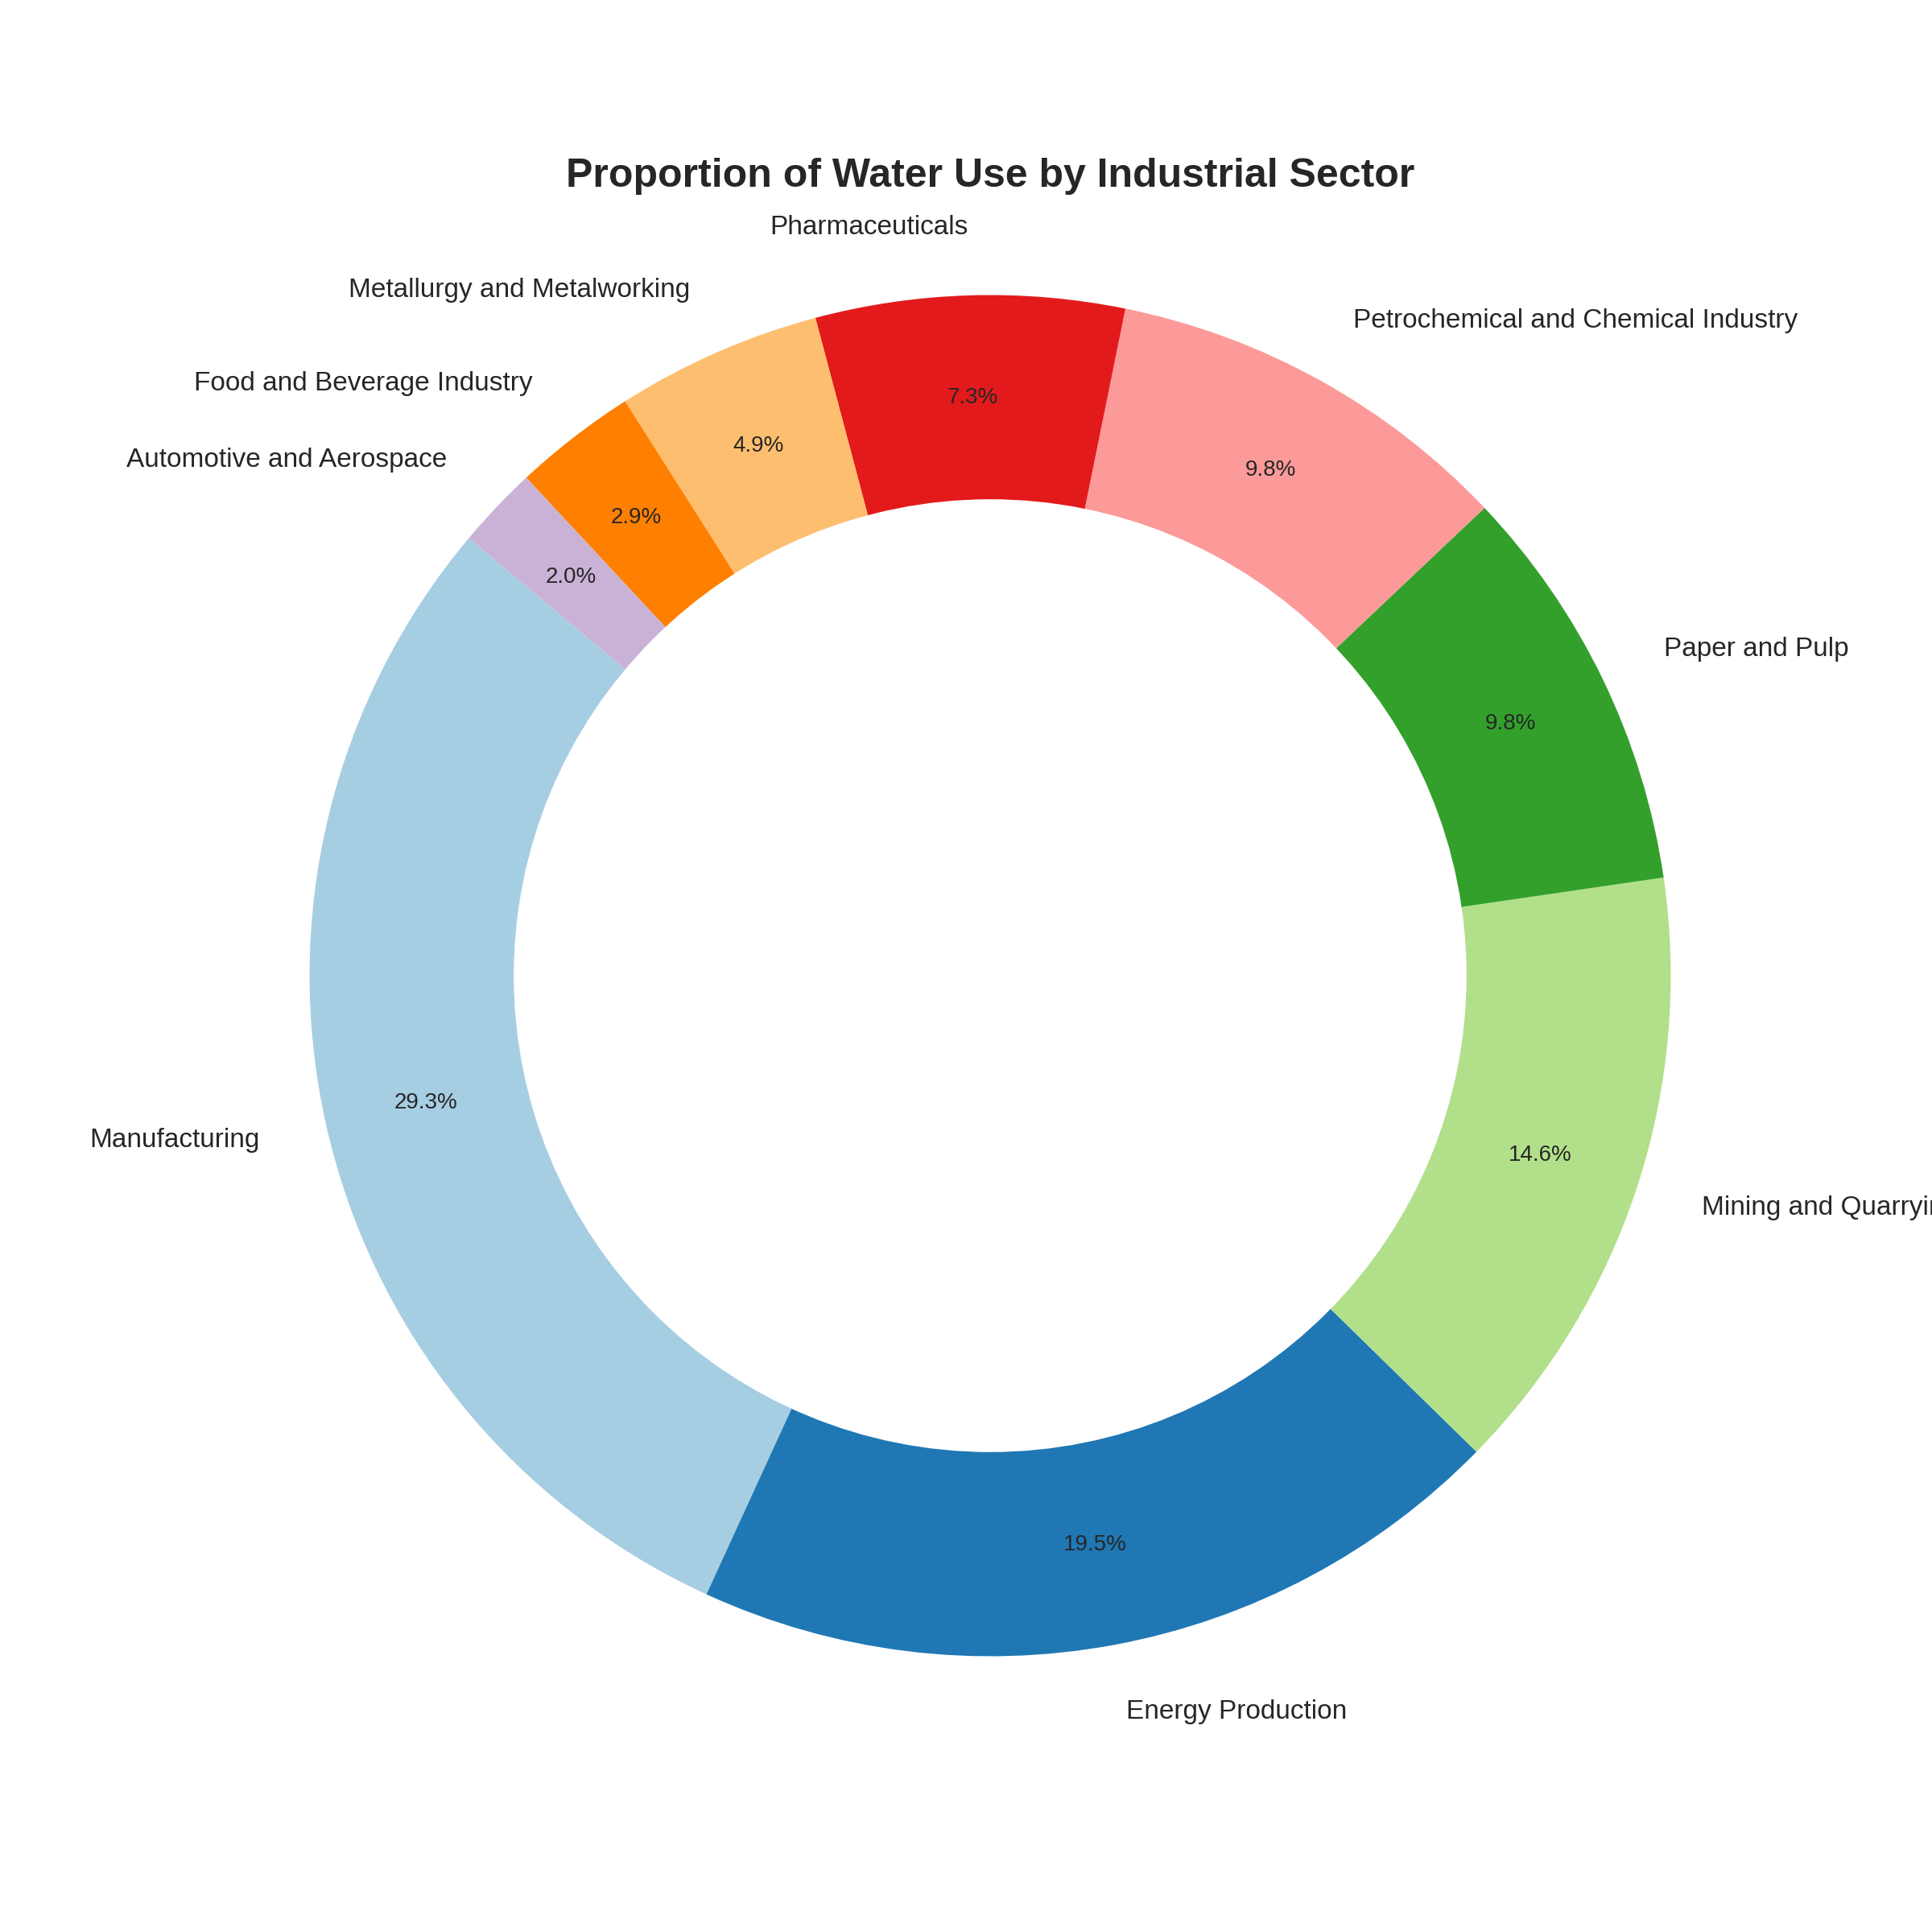
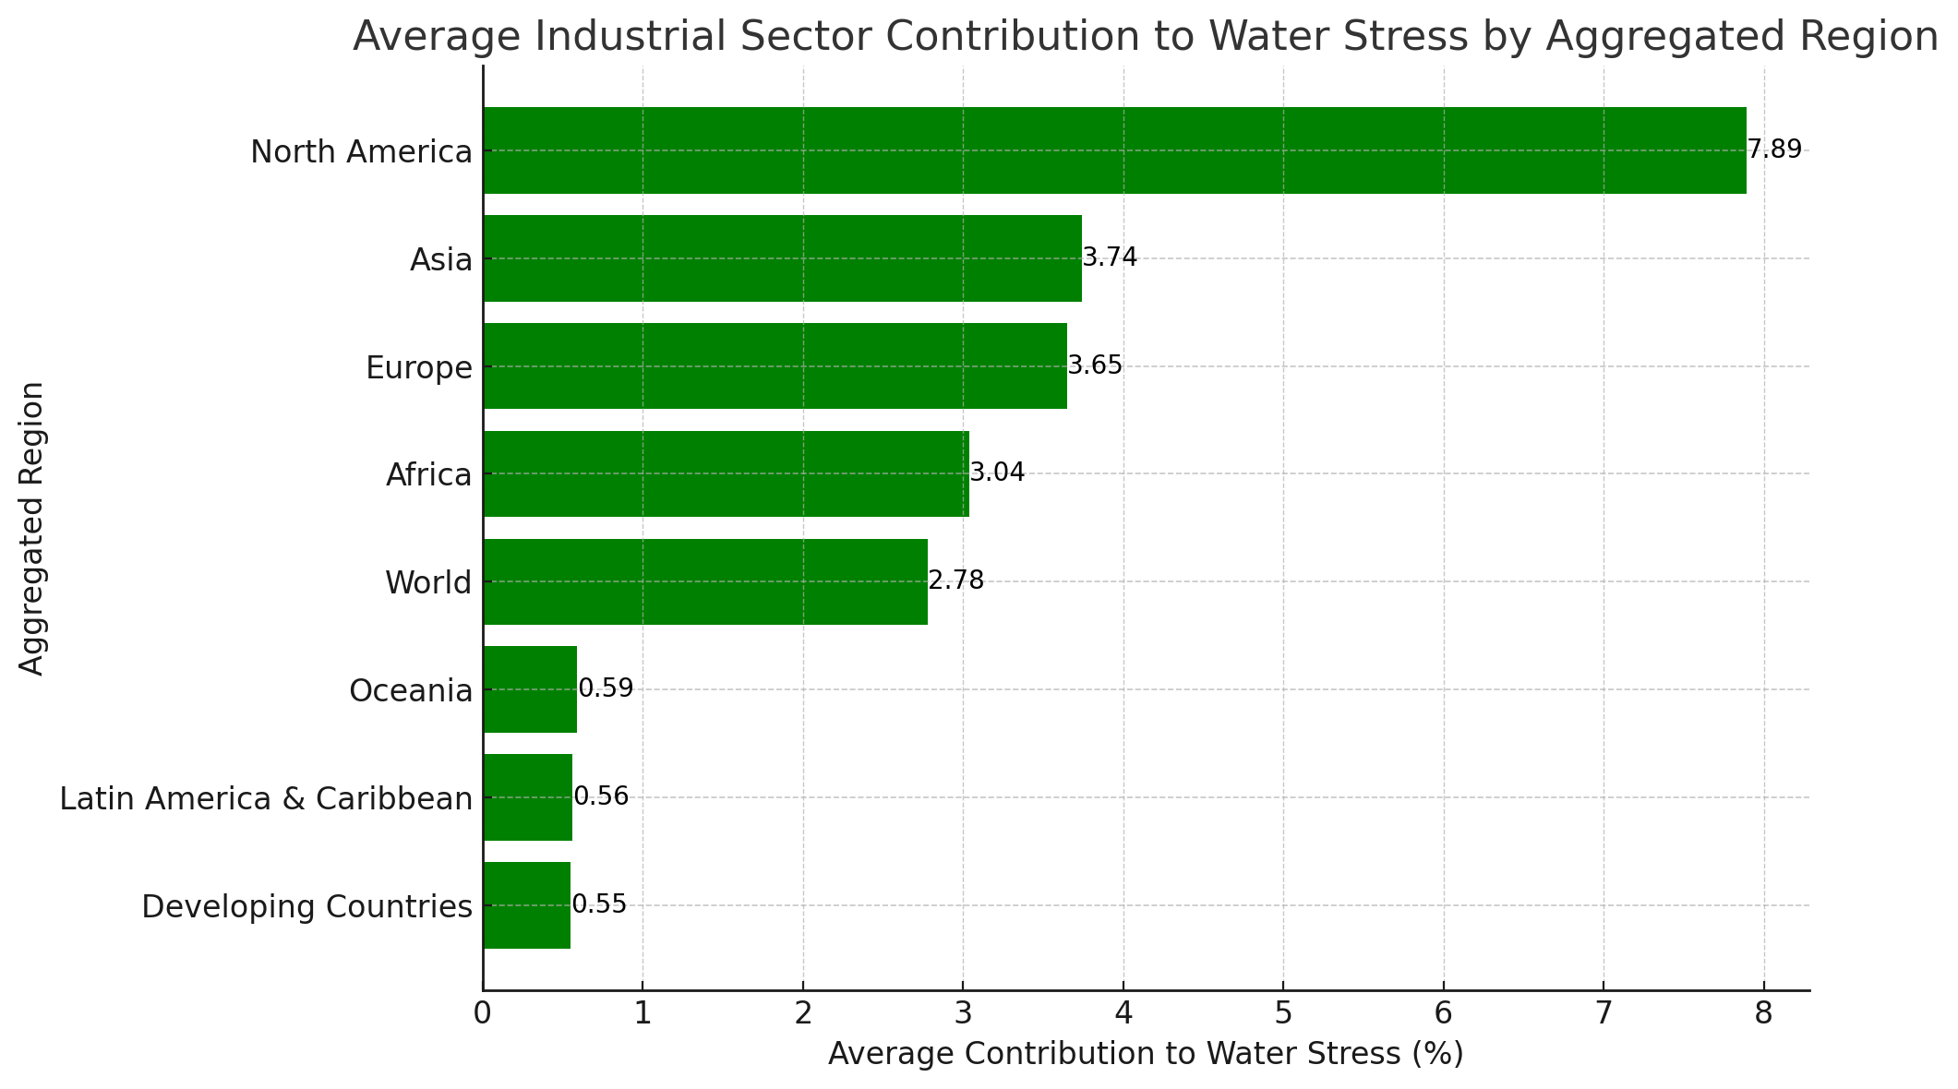
Industry

Slide 14
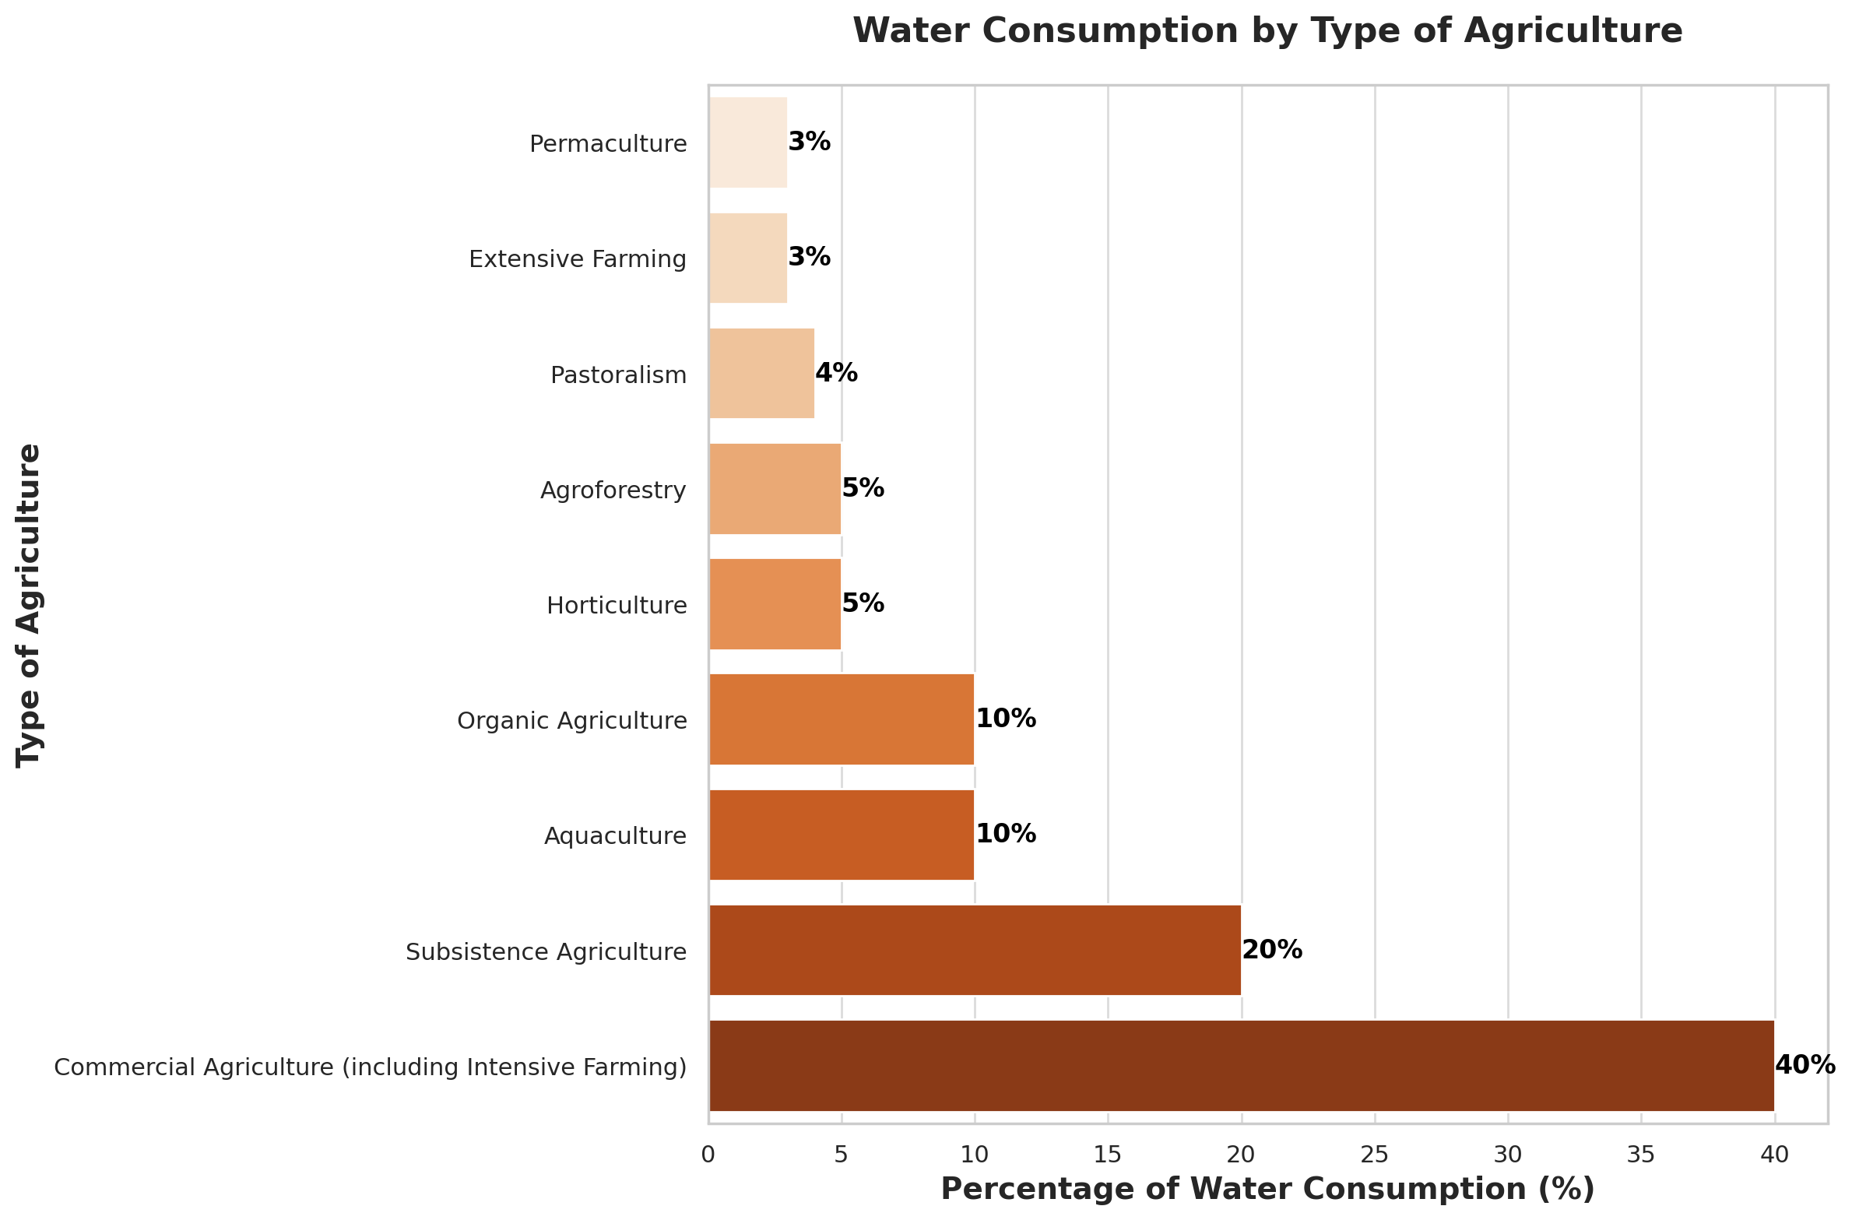
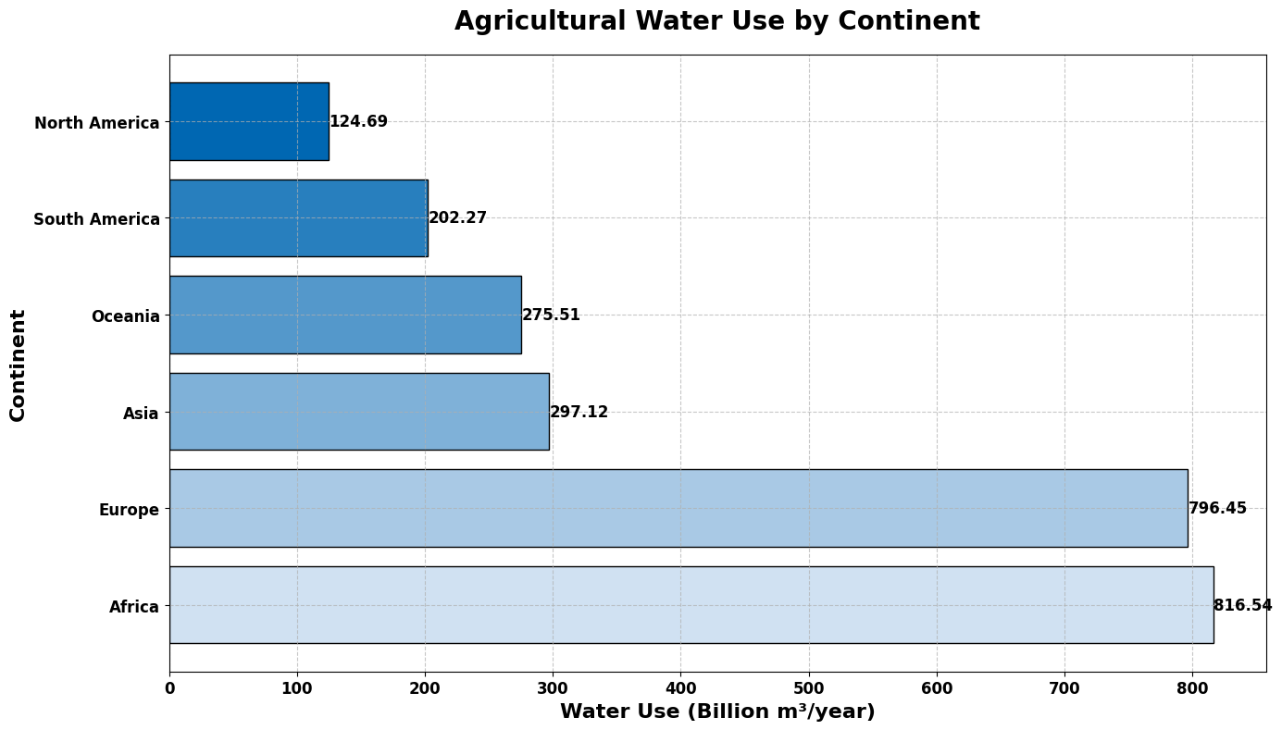
Agricoluture

Slide 15
Earth
Agriculture
Industry
Waste
Deforestation

Slide 16
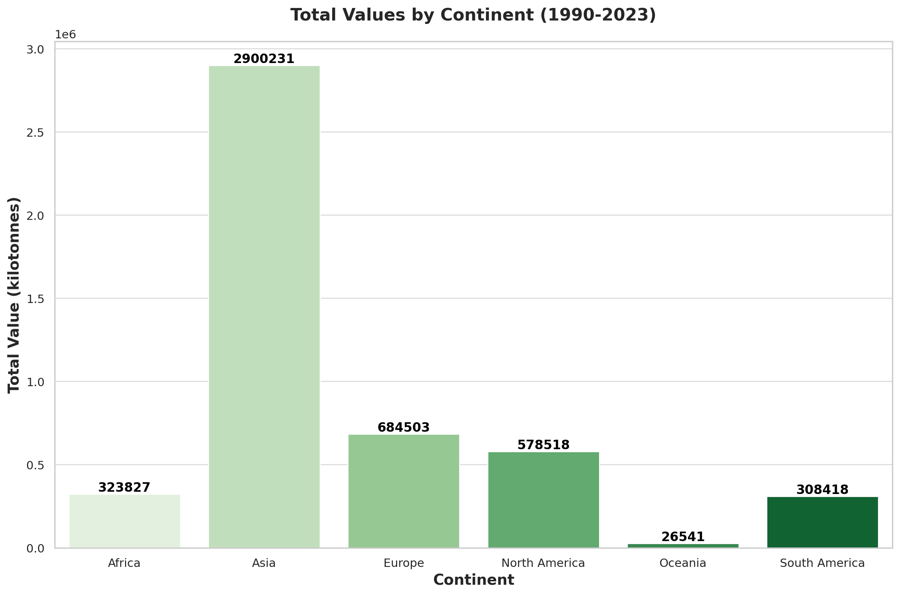
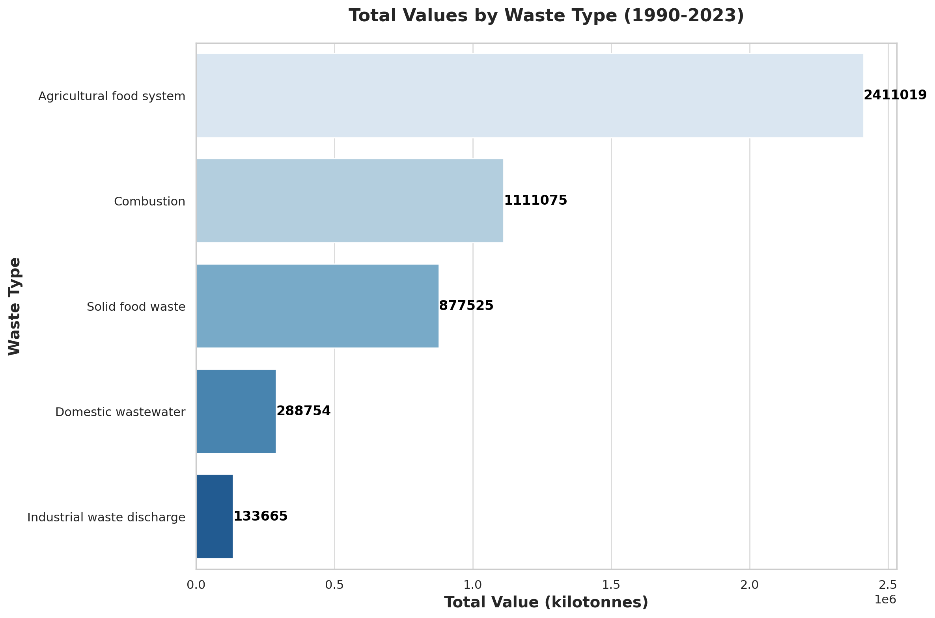
Waste By Type and Continent

Slide 17
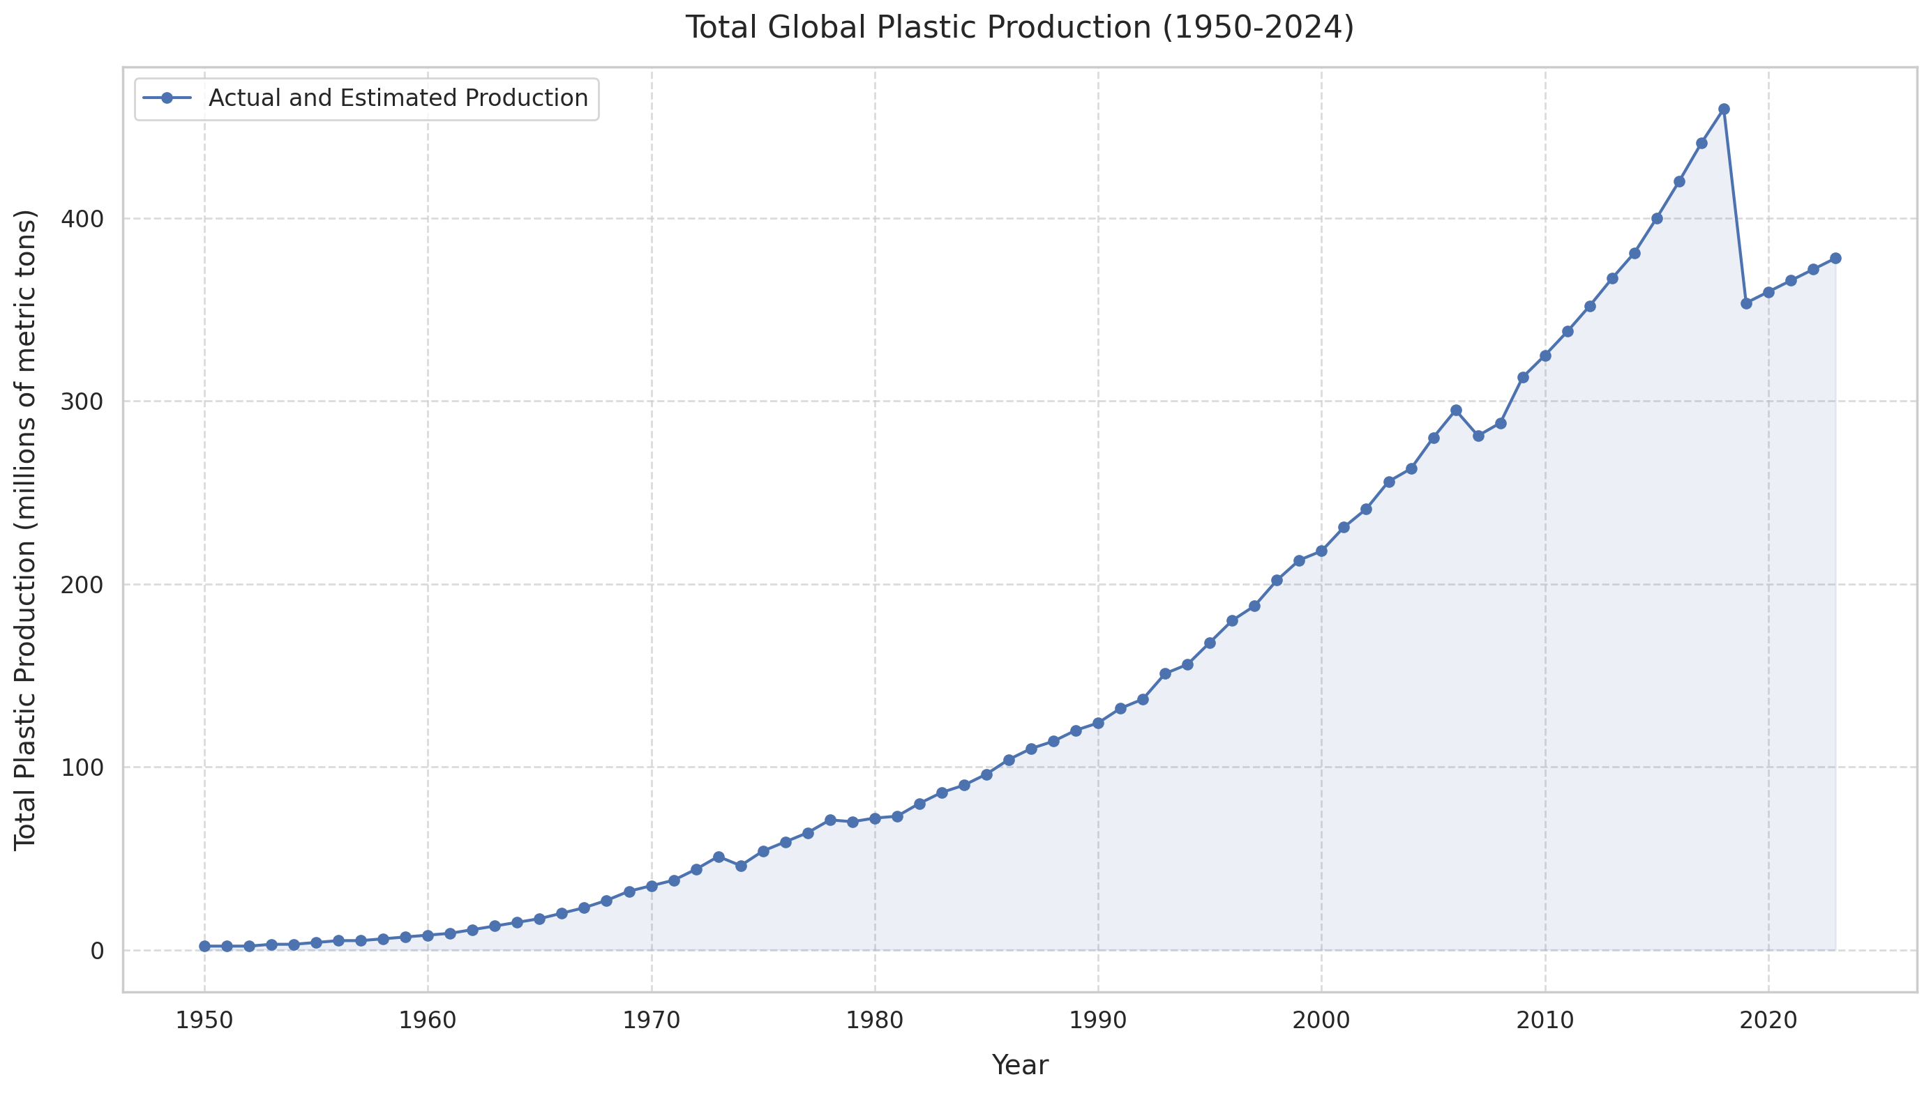
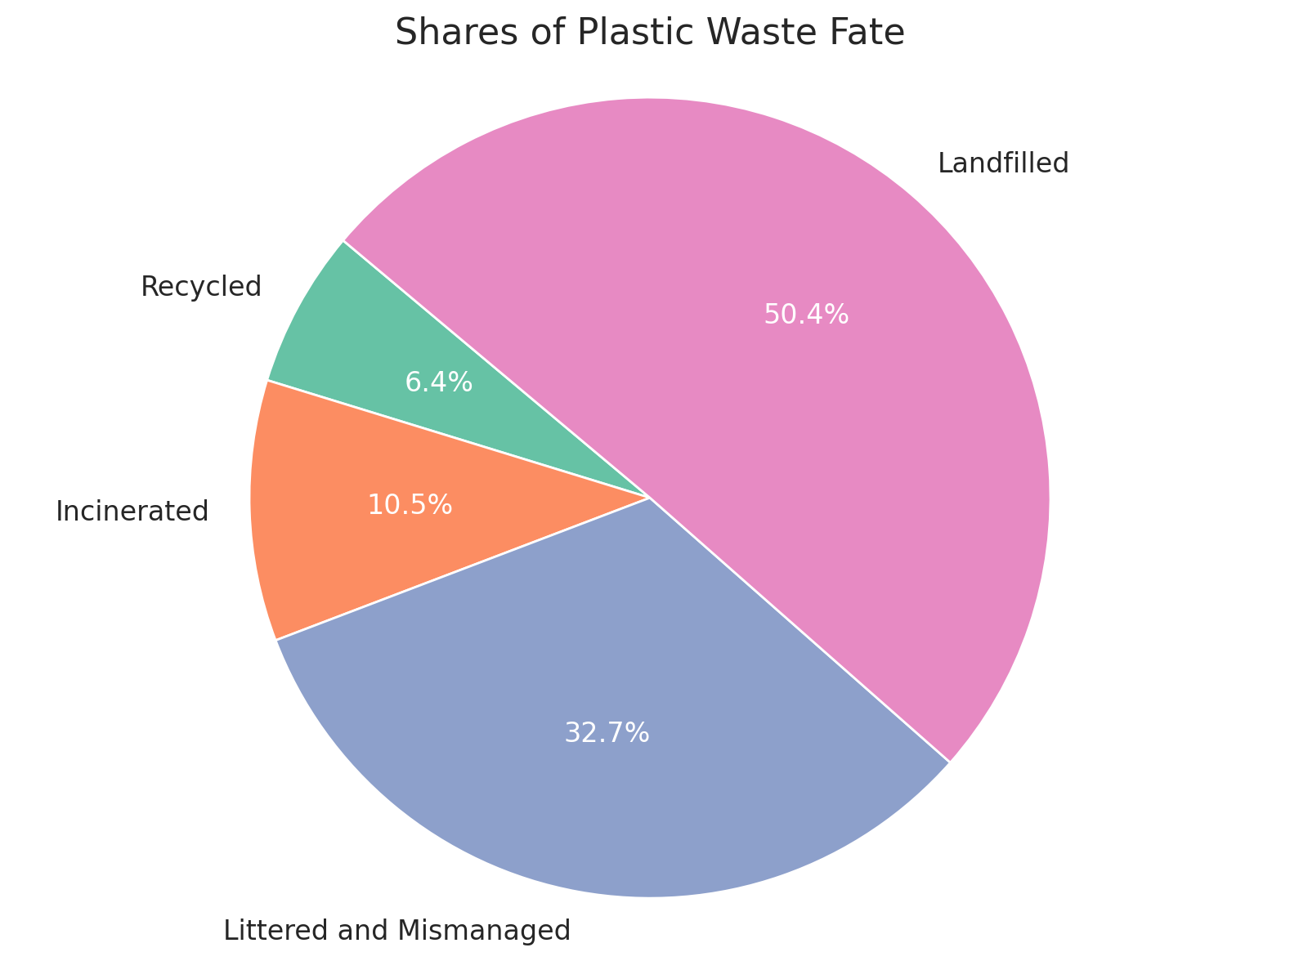
Plastic from 1950 to 2024

Slide 18
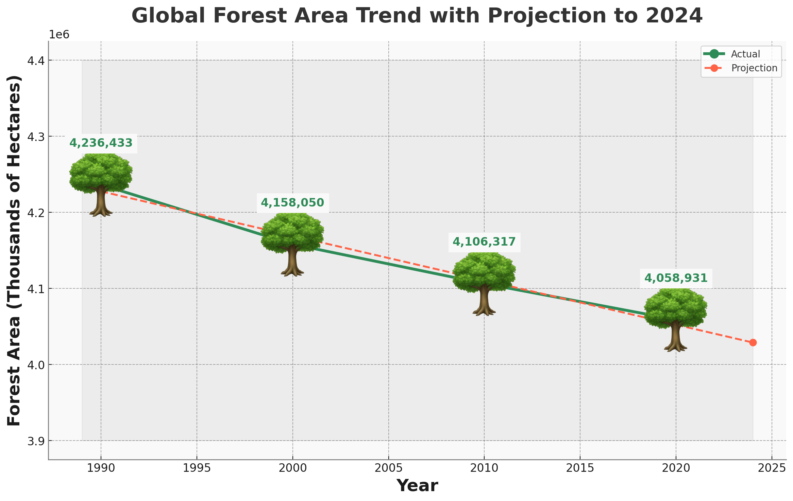
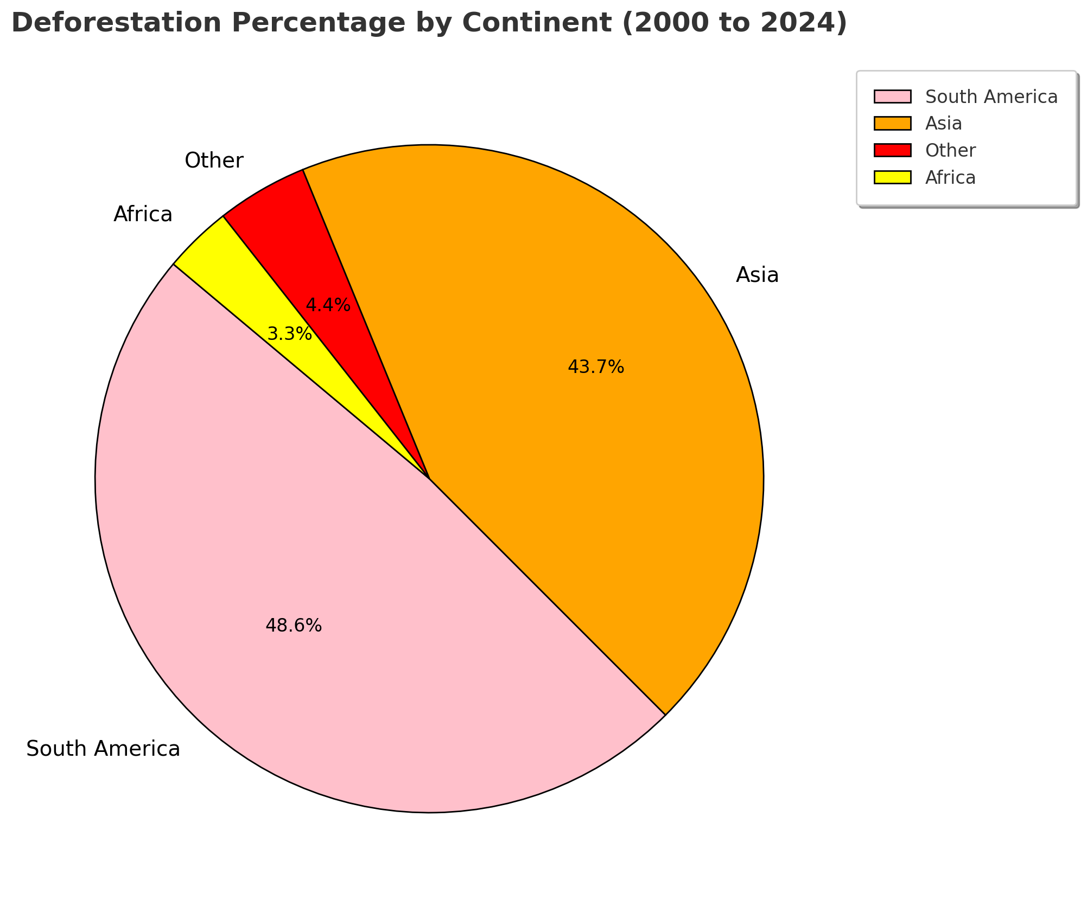
Deforestation

Slide 19
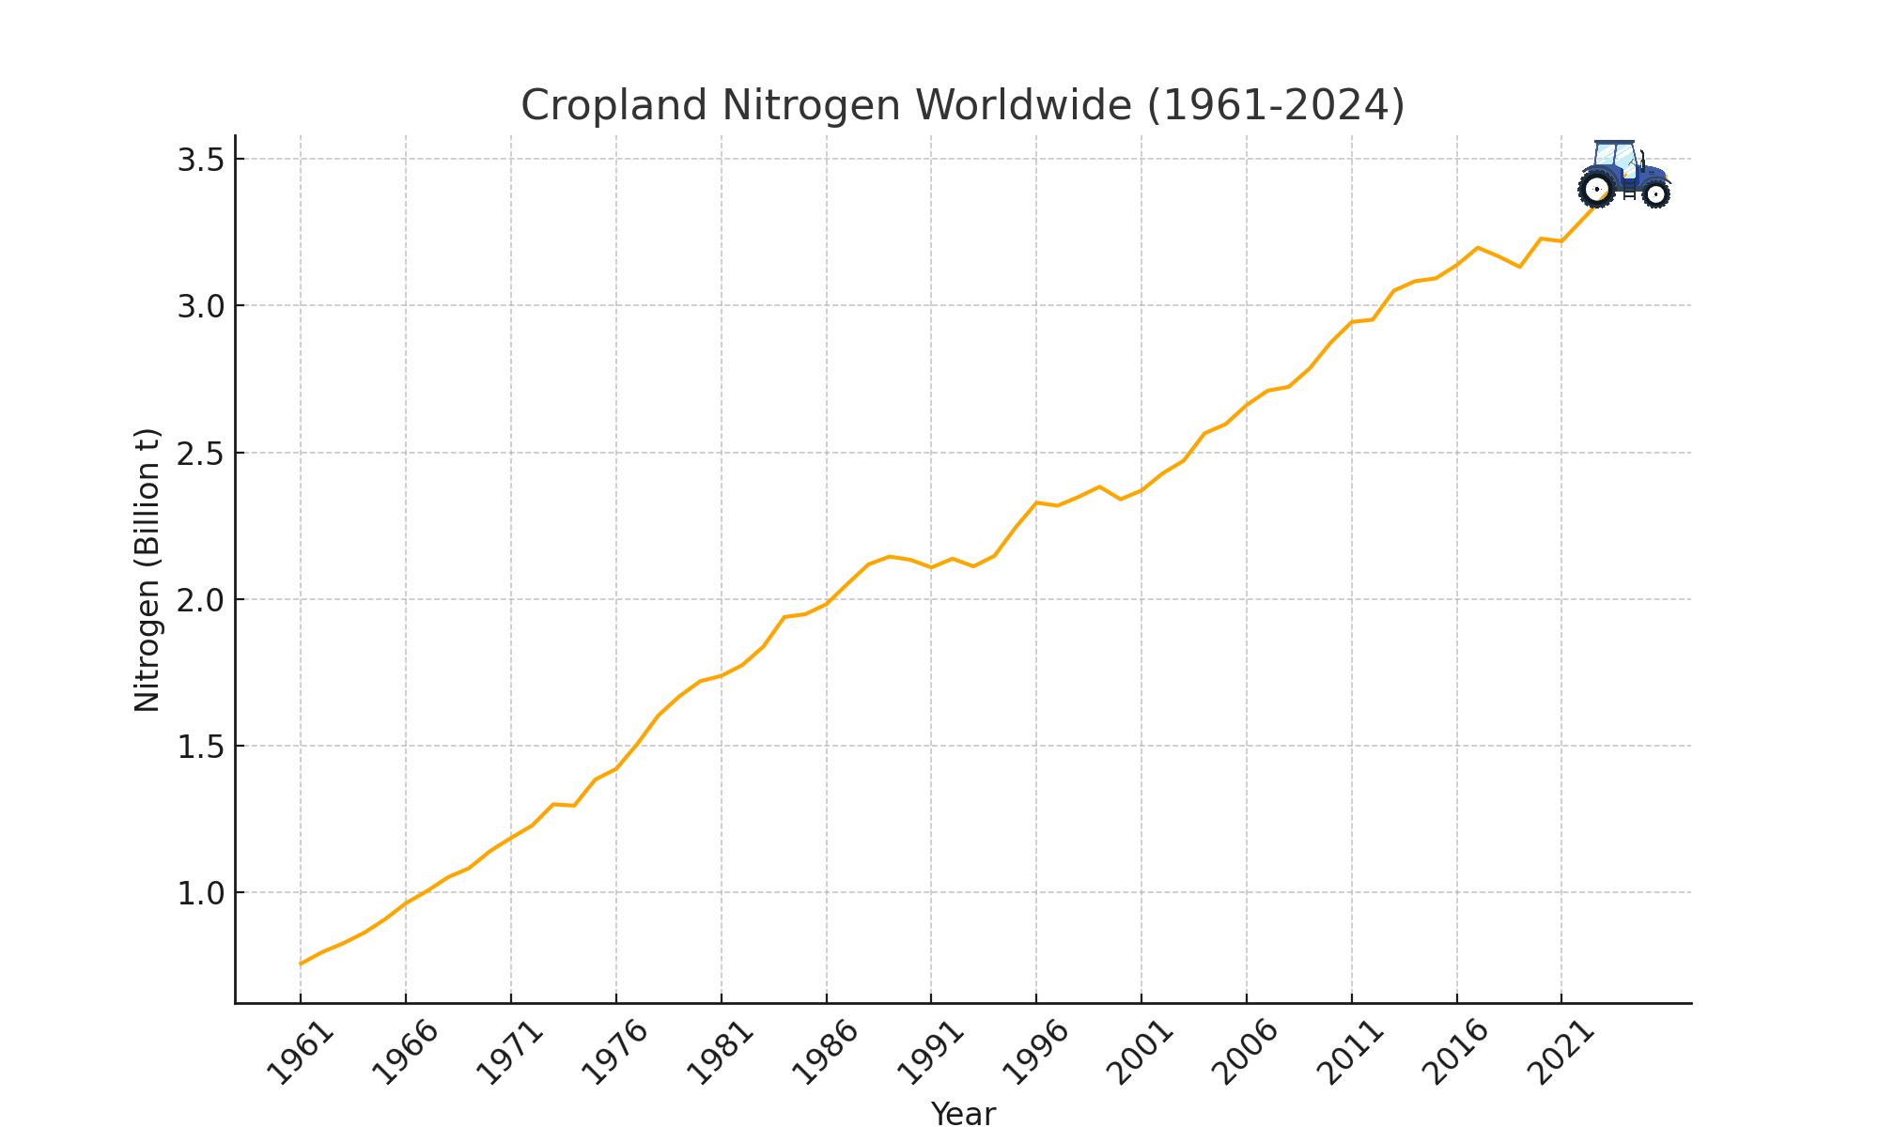
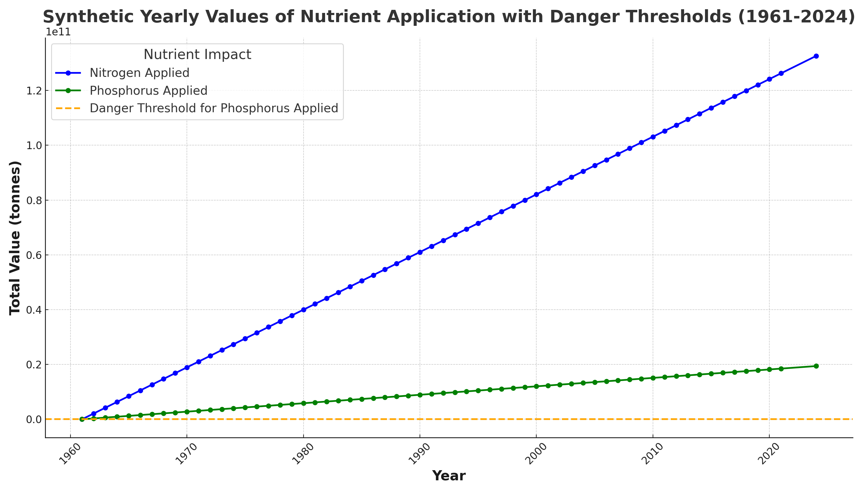
Agricolture

Slide 20
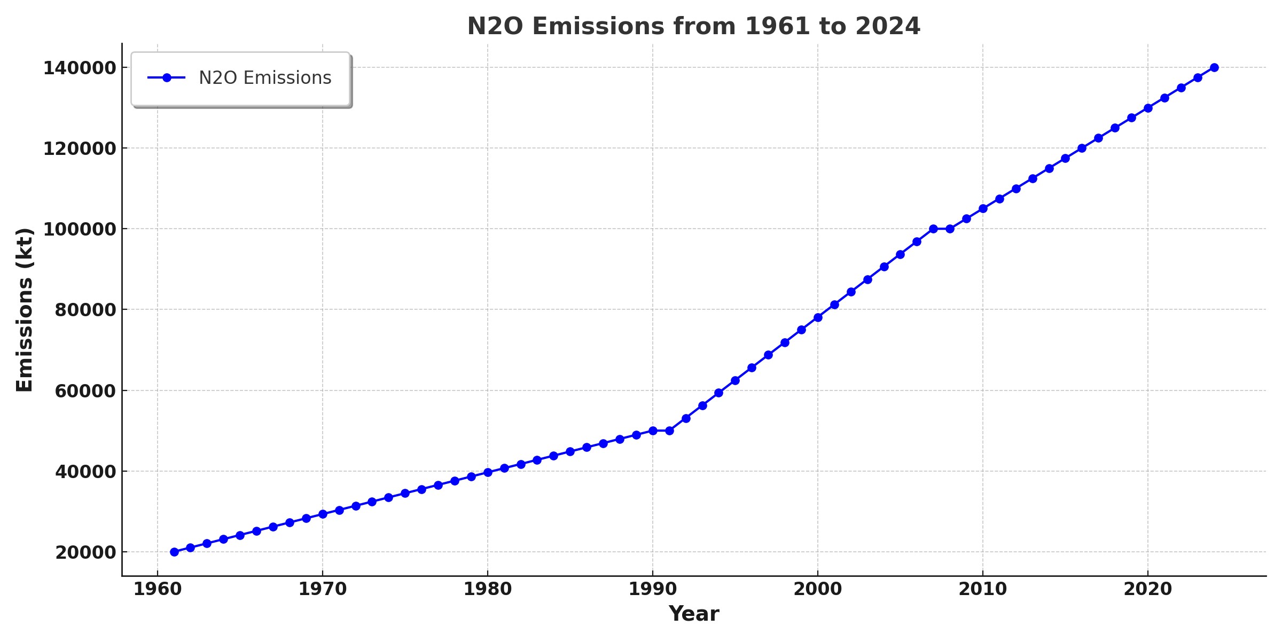
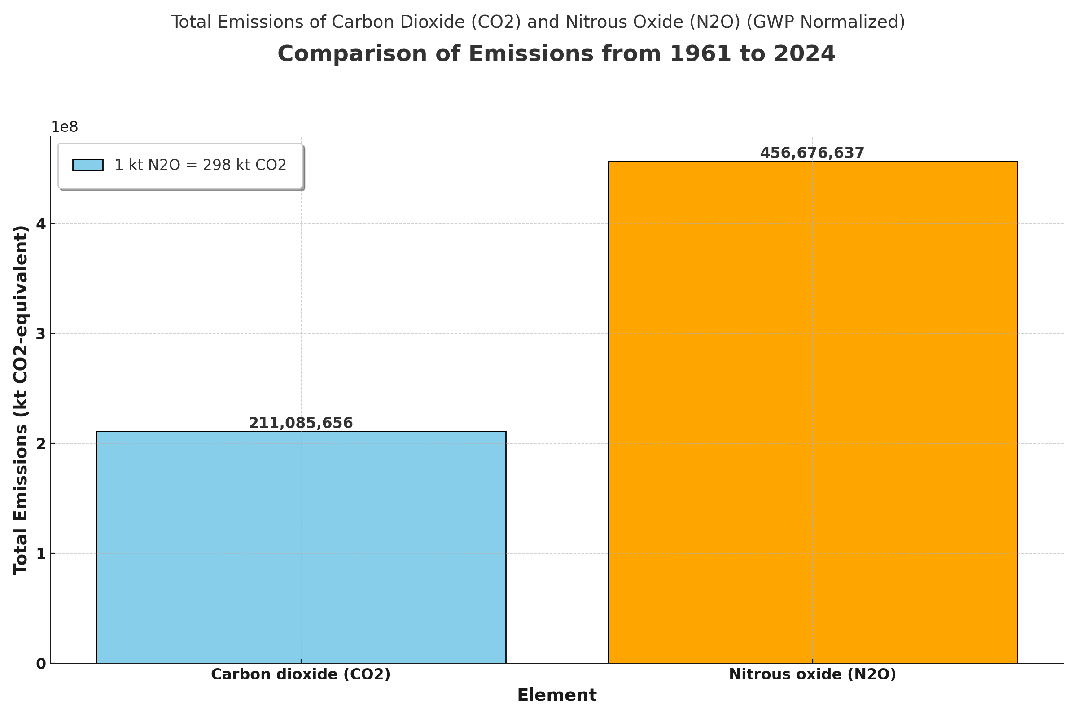
Agriculture: Nitrous oxide

Slide 21



Overall impact
Human Health
Respiratory and cardiovascular diseases
Contamination of water resource
Exposure to toxic chemicals
Environment
Deforestation and desertification
Ocean acidification
Soil degradation
Economy
High healthcare costs
Economic losses in various sectors
Significant investments for remediation

Slide 22
Can we solve the problem by 2025?

Slide 23
Assumptions
Prerequisites for the Application of Climate Solutions
International Cooperation: Global agreements and the role of multilateral organizations.
Political Commitment: Political will and favorable laws.
Financial Resources: Adequate funding and incentives.
Technologies: Access and Research & Development.
Technical Capabilities: Adequate skills and infrastructure.
Awareness: Education and community involvement.
Governance: Good governance and transparency.
Stability: Political and economic stability.
Stakeholder Support: Involvement of governments, private individuals, NGOs and communities.
Climate Emergency: Declaration of climate emergency.

Slide 24
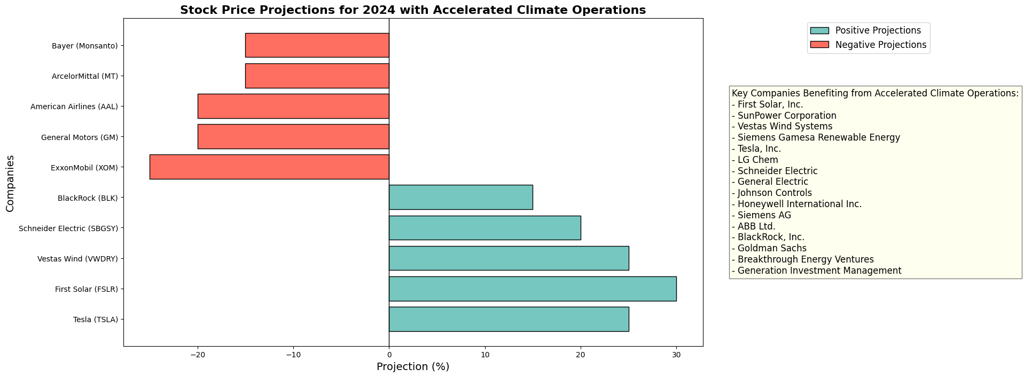
Finance: What would happen if it happened today?

Slide 25
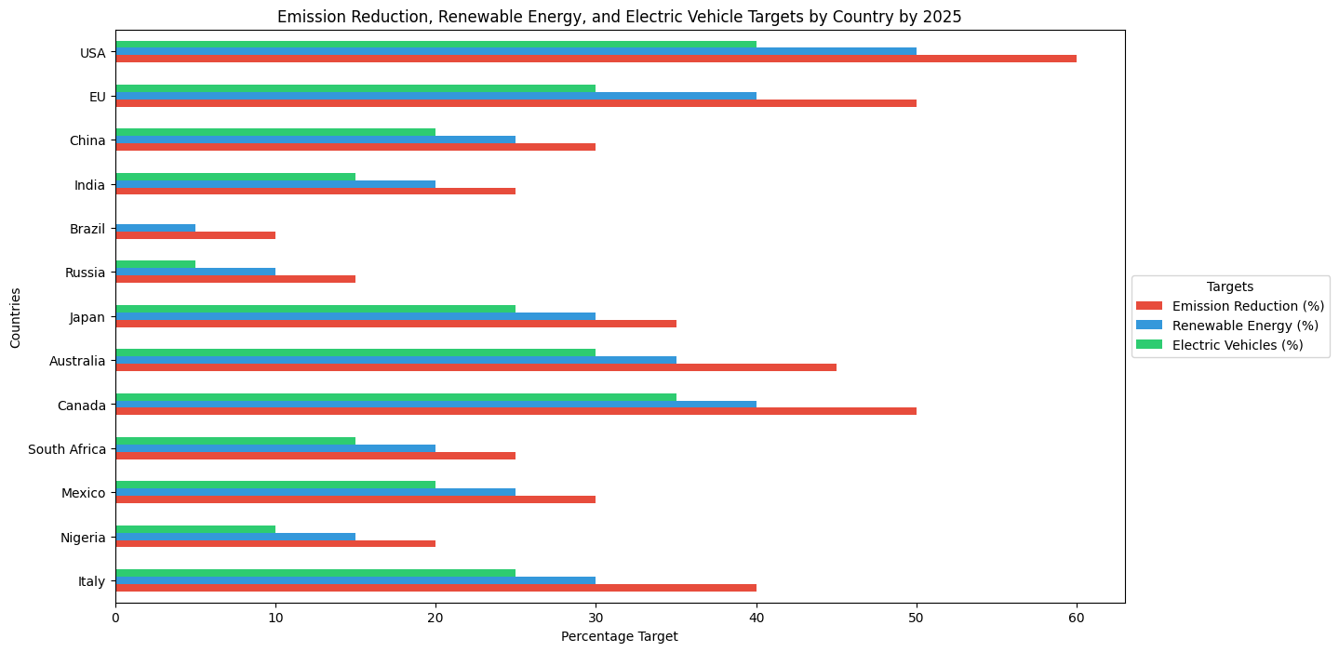
Emission Reduction Target by Country

Slide 26
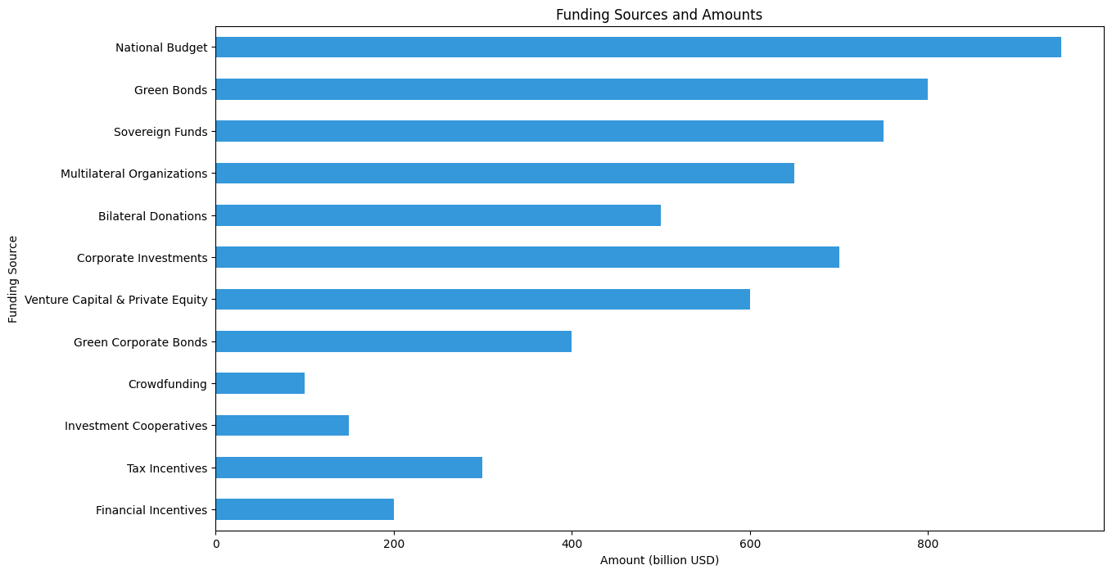
Where do we get the money?

Slide 27
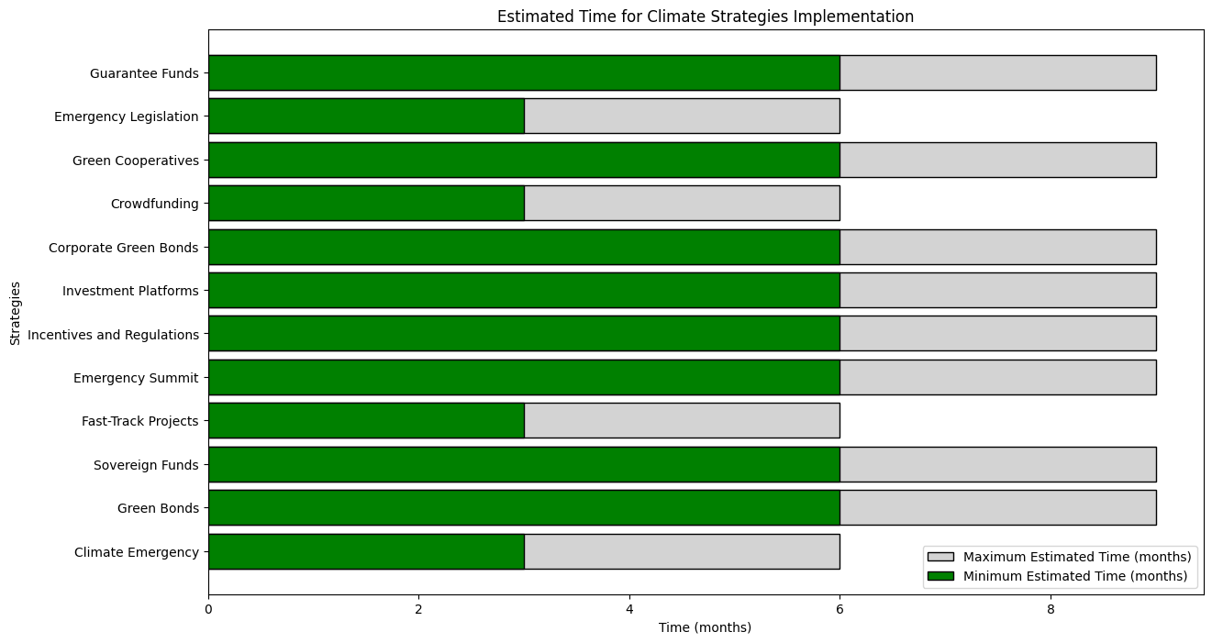
How long does it take?

Slide 28
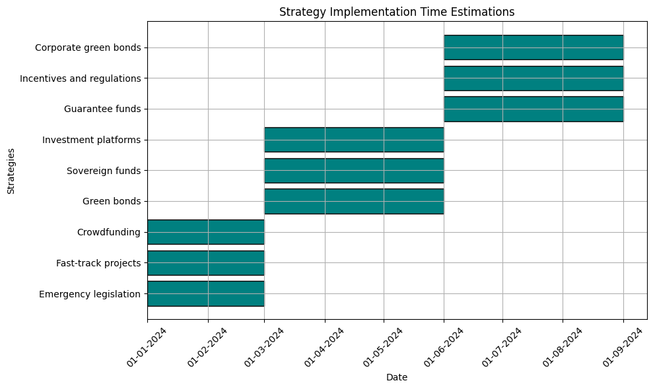
How long does it take?

Slide 29
Conclusions
The estimated probability of implementing climate solutions by 2025 is lower (30-40%) due to current limitations in terms of political will, financing, technological diffusion and international cooperation.
However, by 2030, with greater global commitment and time to improve these factors, the probability of success increases (60-70%). These estimates are based on a qualitative assessment of current trends and potential future evolutions in key sectors.

Slide 30
Sources
United Nations Environment Programme (UNEP): www.unep.org
World Bank Environment Data: databank.worldbank.org
Food and Agriculture Organization (FAO): www.fao.org
Kaggle: www.kaggle.com
Global Forest: www.globalforestwatch.org
The World Health Organization (WHO): https://www.who.int/health-topics/environmental-health

